Slide 1
The Utilization of Machine Learning to Classify Mobile Phone Prices
By: Dina Allen, Daniel O’Brien, and Cassandra Steffey

Slide 2
Project Description
Background
Technology has increased exponentially over the last two decades making it difficult to price mobile phones
Objective
Design a model for retail sellers to price mobile phones according to its components in order to obtain the optimal profit.

Slide 3
Main Tasks
Dataset
Sales and internal component information about mobile phones
Data Preprocessing
Cross tabulations
Correlation Tables
Z-Score Normalization
PCA
Clustering Methods
K-Means
Classification Models
KNN
Decision Trees
Naive Bayes
Support Vector Machine

Slide 4
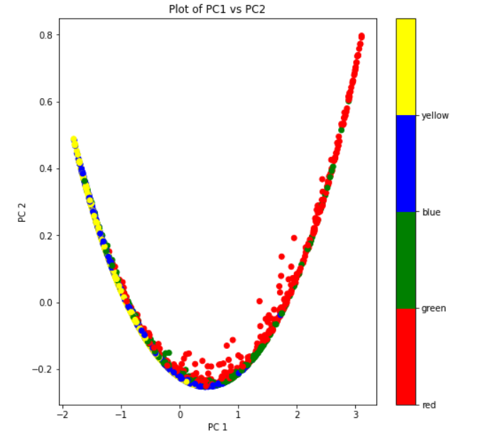
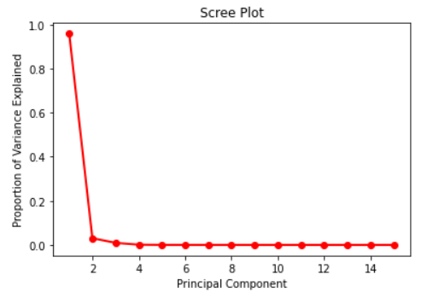
Principal Component Analysis - Results
Principal Component Analysis was performed
and found that the first two principal
components accounted for 99% of the
variance in the data.

Slide 5
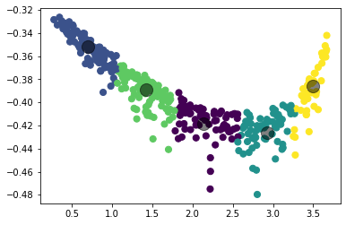
K Means Clustering - Results
K Means Clustering performed best with 5 clusters and showed the following metrics:
Completeness score = 0.22
Homogeneity score = 0.24
Mean Silhouette Value = 0.52

Slide 6
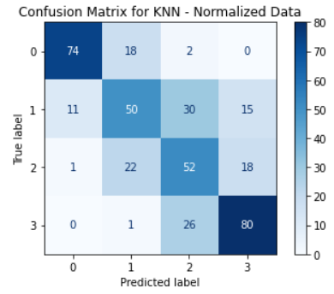
K Nearest Neighbors - Results
KNN was performed on the normalized data and on the principal components. The best performing method had the following parameters:
N_neighbors = 7
Weights = ‘uniform’
Normalized data
This model had a 70% accuracy on the
training dataset and a 67% accuracy on the
testing dataset

Slide 7
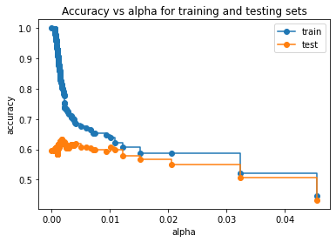
Decision Trees - Results
Initial Results:
Training = 0.99
Testing = 0.59
Post-Pruning with Cost-Complexity Pruning
ccp_alpha = 0.01
Results after Post-Pruning:
Training = 0.67
Testing = 0.63

Slide 8
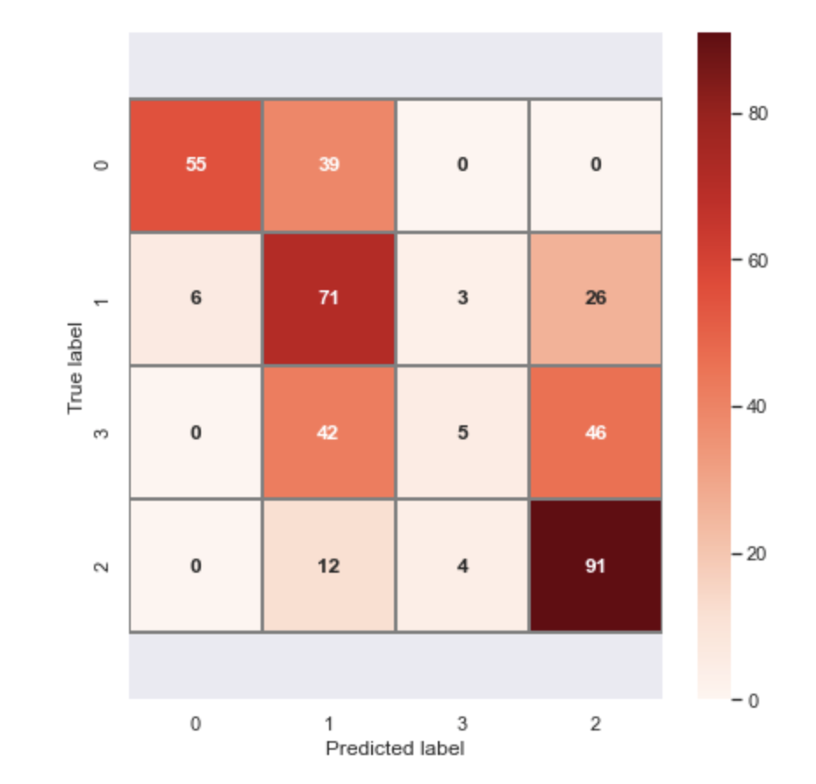
Naive Bayes - Results
The best performing model used a gaussian distribution with the normalized data.
This model had a testing accuracy of 55.5%

Slide 9
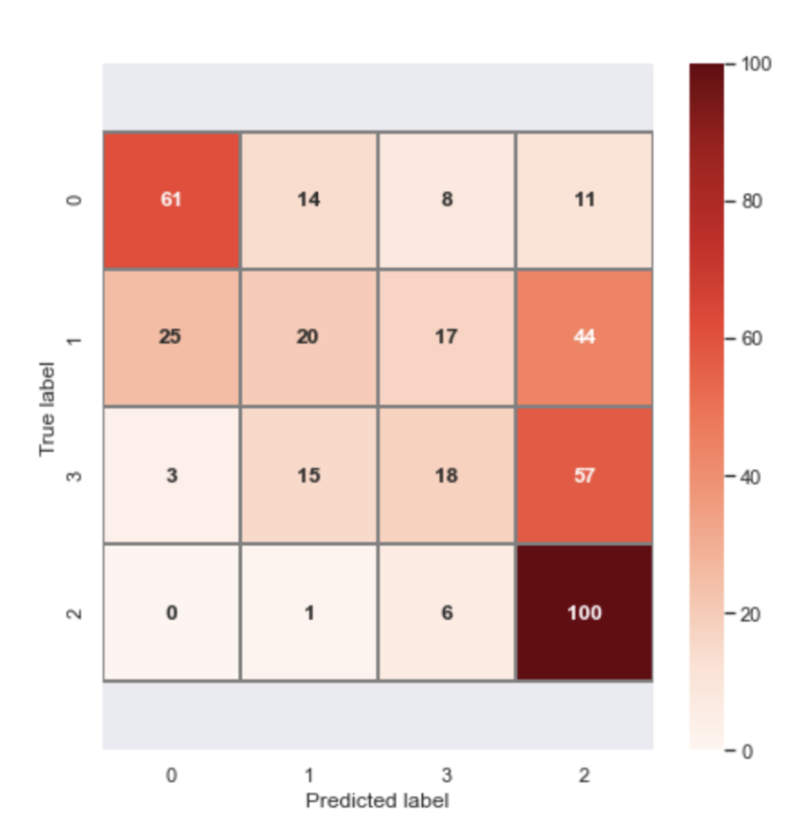
Support Vector Machine - Results
A Support Vector Machine model was performed on data transformed using the first two principal components.
The best performing model had an accuracy of 49.75% and used the following parameters:
Kernel = RBF
C (Width of Margin) = 10
Gamma (Size of Radial Basis) = .01

Slide 10
Conclusion
The best performing model was KNN with a testing accuracy of 0.64 or 64%

Slide 11
Thank You!

